Slide 1
Tides, Shakes and Earthquakes
Tsunami Delay in Buoy data after 2011 Japan earthquake
By Hannah N and Jett R

Slide 2
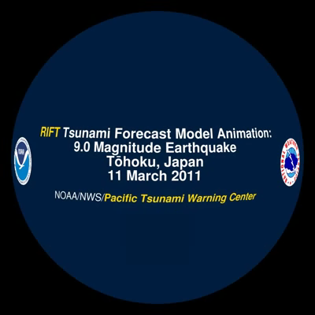
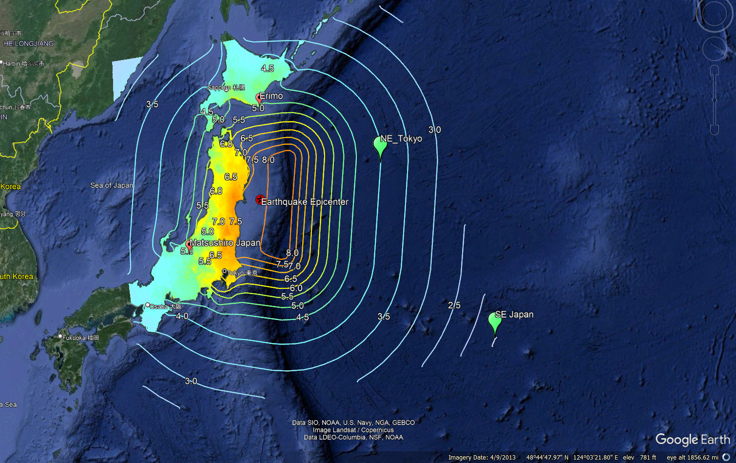
March 11, 2011 M9.1
Inundation 6 miles inland near Sendai
Lead to the Fukushima Nuclear Incident
Measured Wave Heights – 33ft (Coast of Japan)
Notes:
Wave Amplitude is related to ocean depth, deep waters mean lower waves, shallow = High .
Waves decay with distance , waves reflected both can intensify and dampen each other.
Really high frequency's may be from choppy waters , lower frequencies may be daily tides, middle frequencies give us an idea of each passing wave.

Slide 3
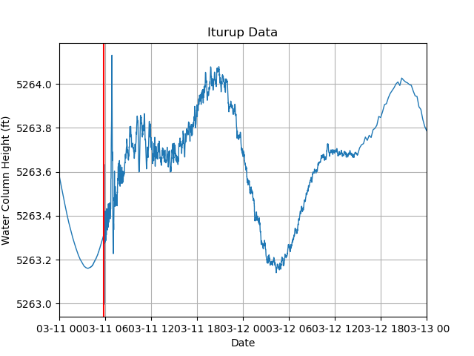
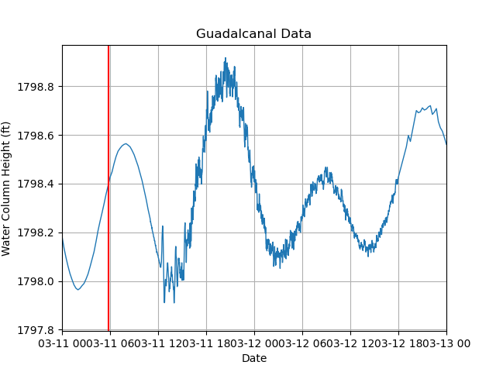
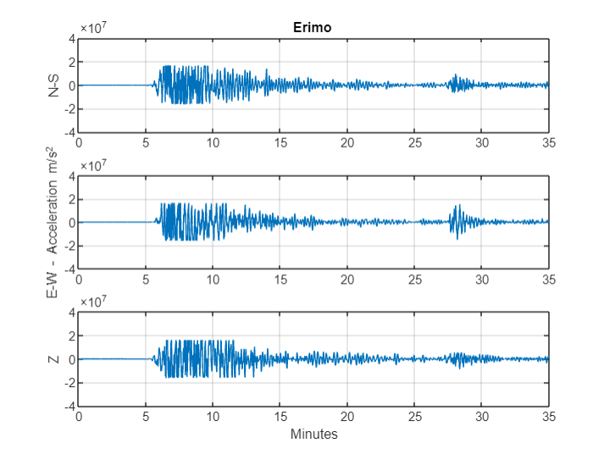
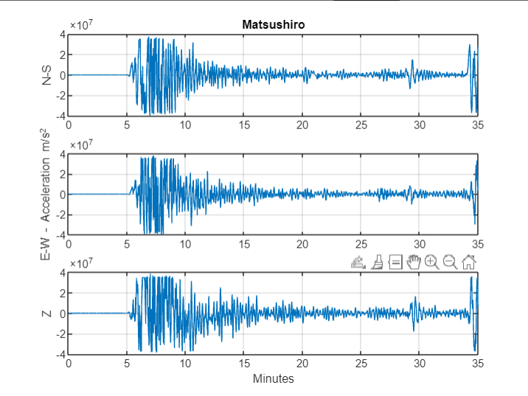
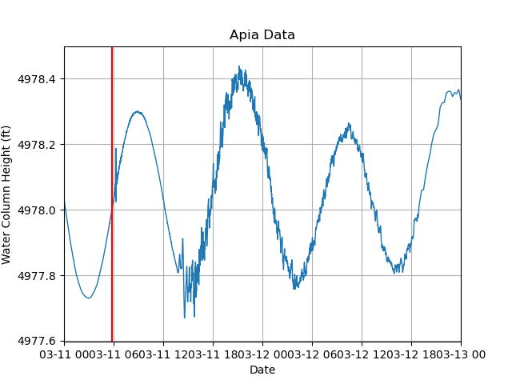
Data
SAGE – Seismograms - acceleration
NOAA NDBC – Buoys – water column height
What does the tsunami signal look like in tidal buoy data at stations across the Pacific Ocean?
How can we filter the data to separate the tsunami signal from the tides?

Slide 4
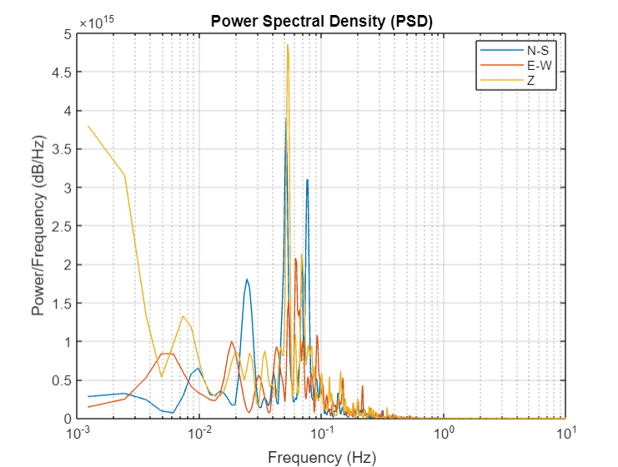
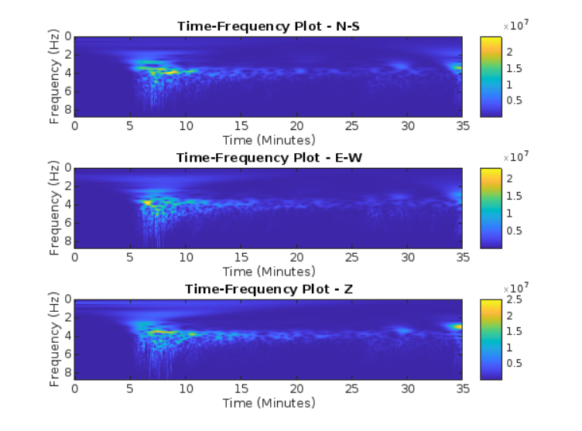
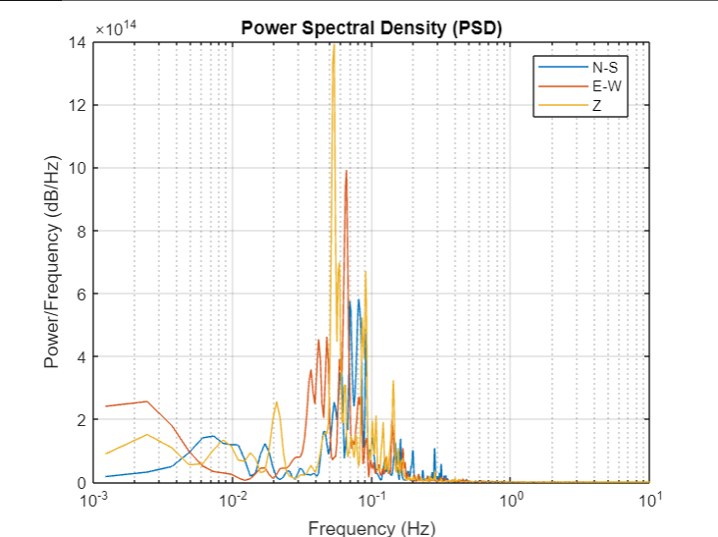
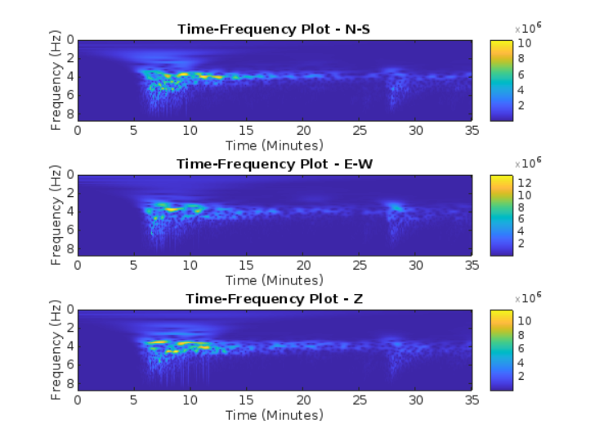
Matsushiro Japan
What frequencies Make up the signal?
When are the frequencies happening?
What does the EQ look like?
Anything else?
Erimo Japan

Slide 5
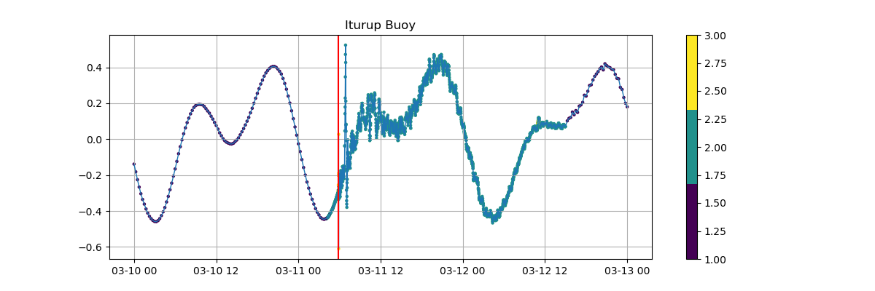
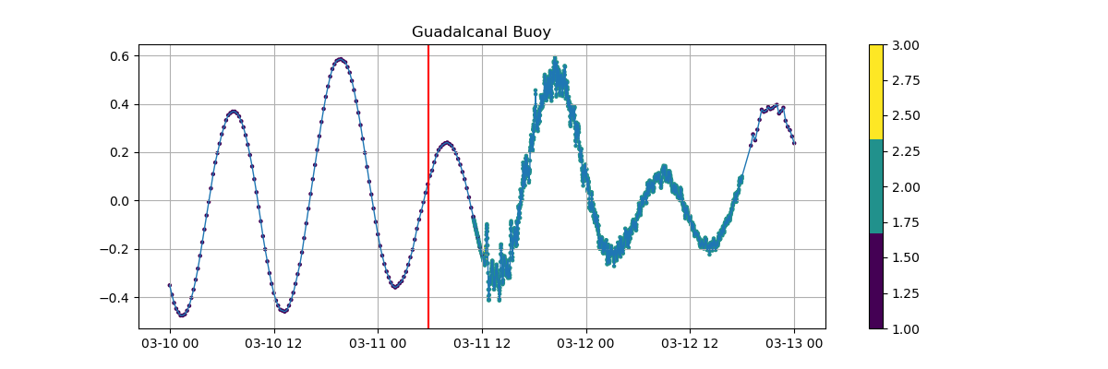
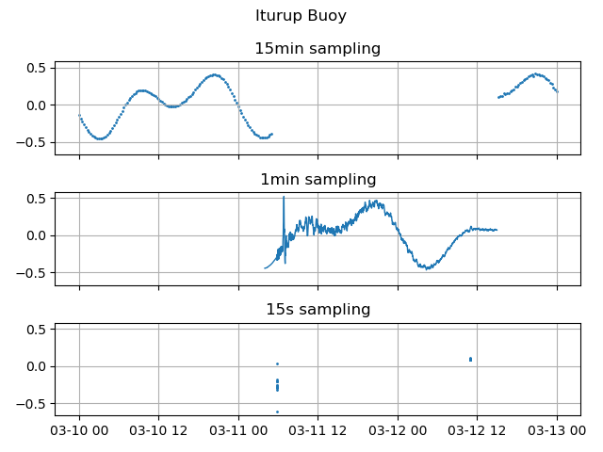
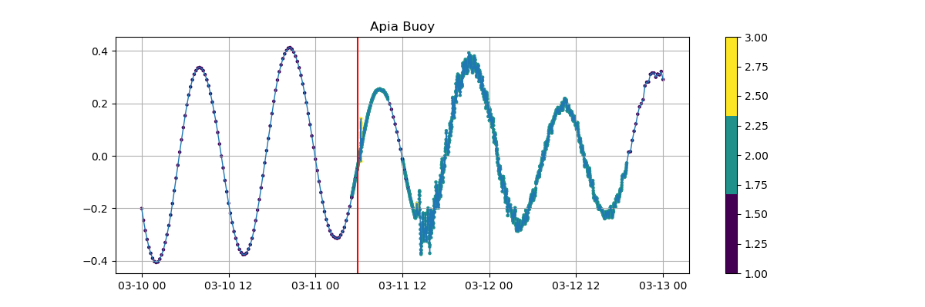
Sampling Rates
Tide buoys do not transmit signals at a consistent sampling rate
Data is at a frequency of 15 minutes, 1 minute, or 15 seconds

Slide 6
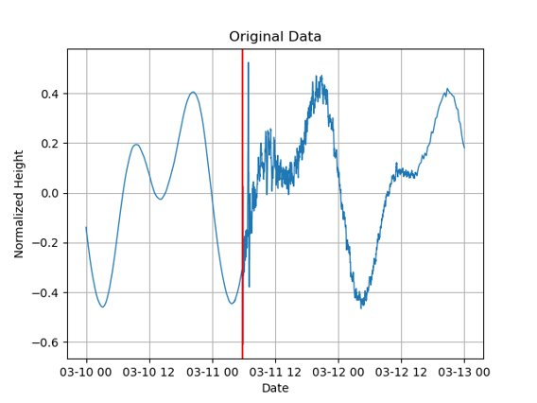
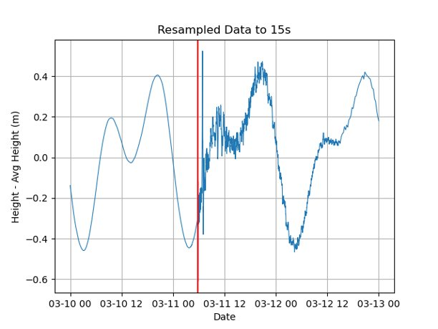
Resampling the Data
Resample the data to a consistent 15s sampling frequency using linear interpolation to fill missing values
Figures are Iturup Station Close to Epicenter

Slide 7
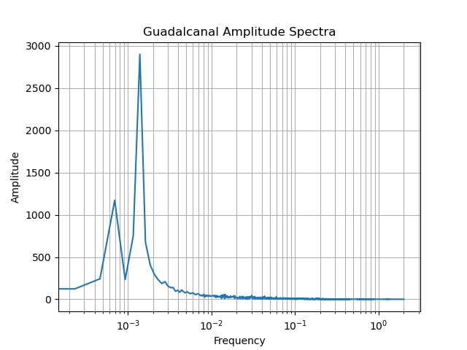
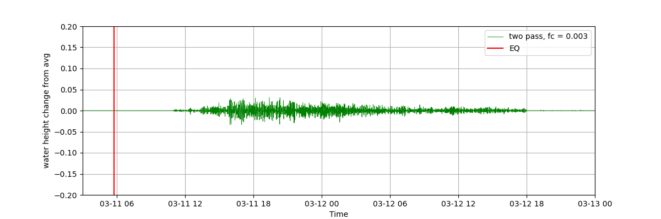
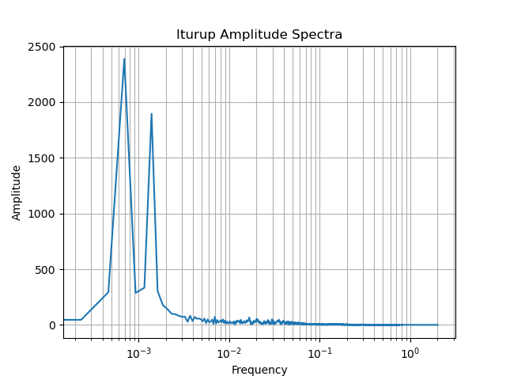
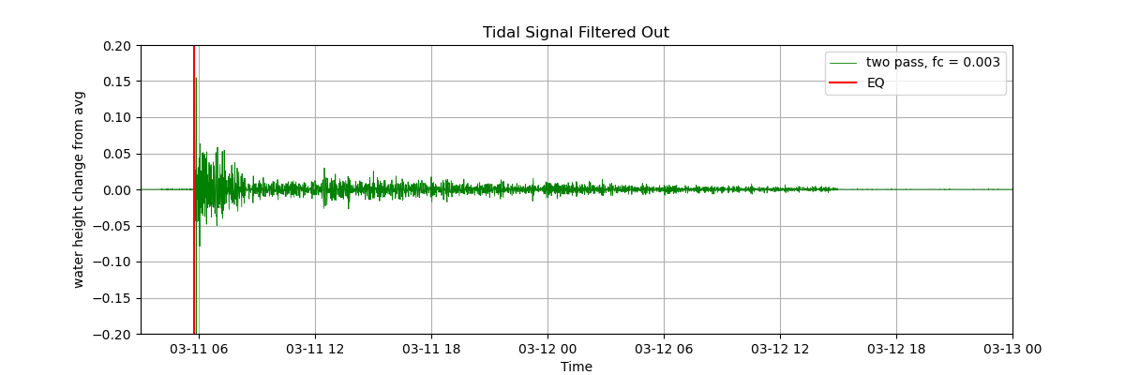
Filtering the Signal
High-pass Butterworth Filter
Cutoff frequency determined by looking at the Amplitude Spectrum – 0.003 Hz was pretty standard
Low Frequencies – Daily Tides

Slide 8
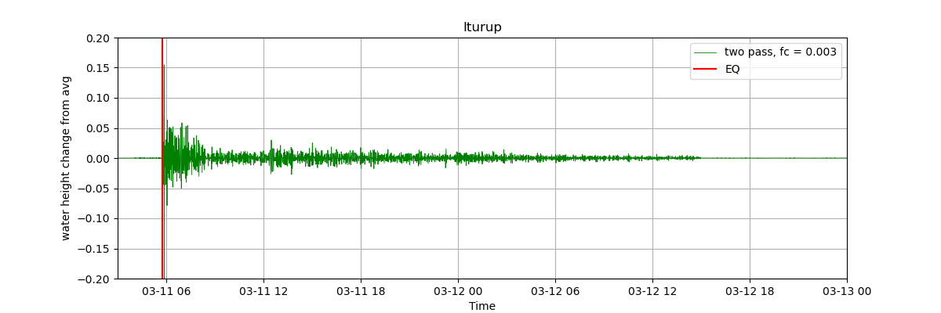
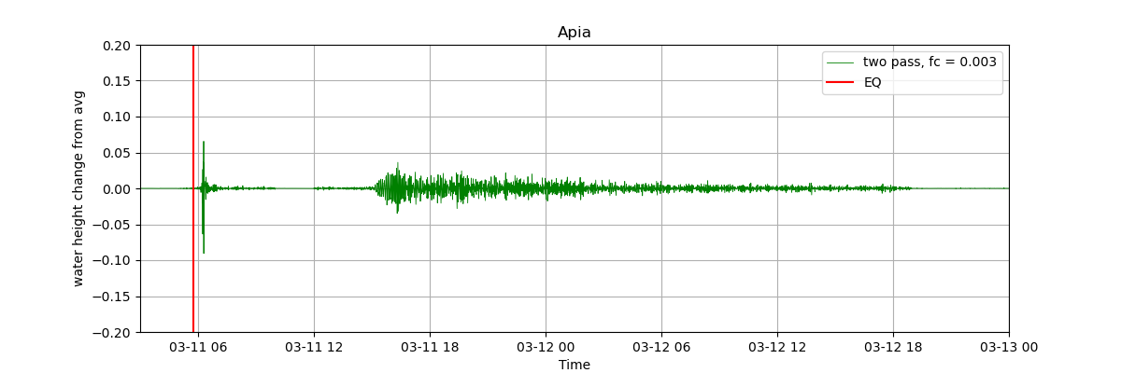
Tsunami Delay with Distance
NE Japan, Iturup, Attu AK, Townsville, Apia

Slide 10
Sources
National Oceanic and Atmospheric Administration (n.d.). National Data Buoy Center. NOAA NDBC. Retrieved March 1, 2024, from https://www.ndbc.noaa.gov/obs.shtml
National Oceanic and Atmospheric Administration (n.d.). On This Day: 2011 Tohoku Earthquake and Tsunami. National Centers for Environmental Information. Retrieved March 6, 2024, from https://www.ncei.noaa.gov/news/day-2011-japan-earthquake-and-tsunami
SAGE Seismological Facility for the Advancement of Geoscience (n.d.). SAGE Wilber 3 Select Stations. Retrieved February 23, 2024, from https://ds.iris.edu/wilber3/find_stations/3279407
United States Geological Survey (n.d.). M 9.1 - 2011 Great Tohoku Earthquake, Japan. USGS Earthquake Hazards Program. Retrieved March 2, 2024, from https://earthquake.usgs.gov/earthquakes/eventpage/official20110311054624120_30/executive

